Slide 1
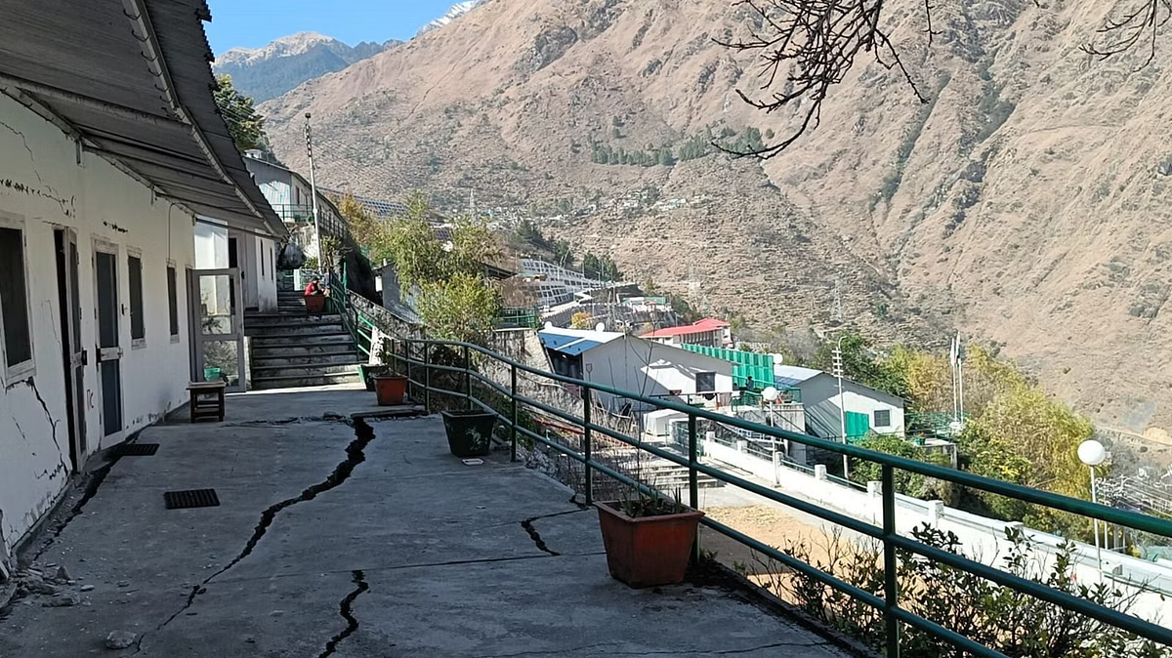
Joshimath: A Sinking Town ,
A Cautionary Tale

Slide 2
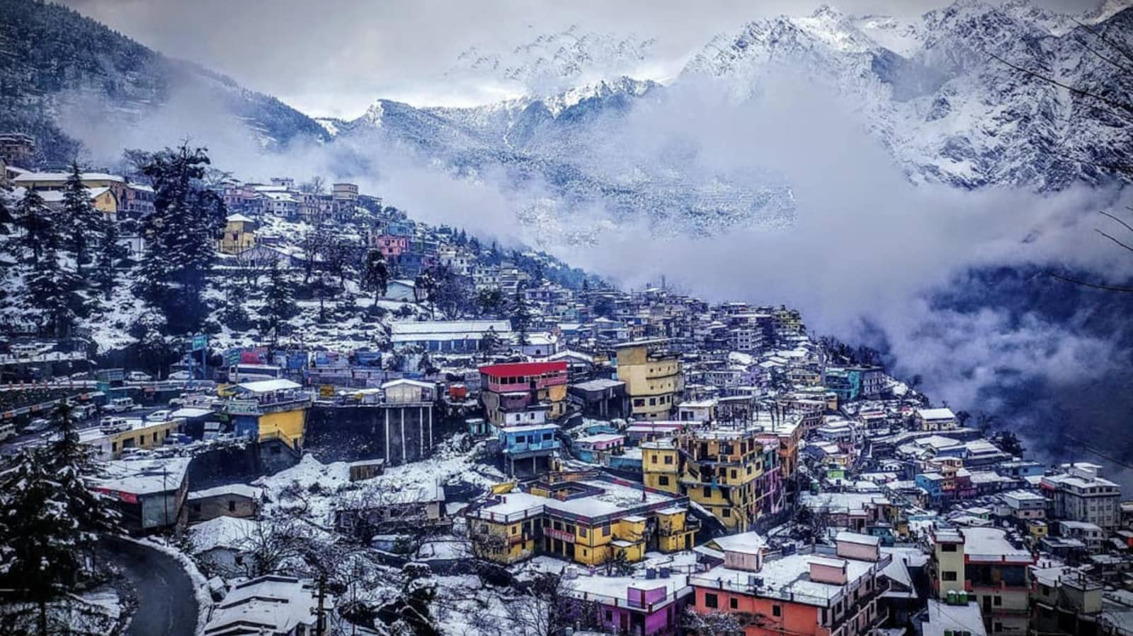
Joshimath - A Picturesque Himalayan Town
Joshimath, a town nestled amidst the awe-inspiring peaks of the Indian Himalayas, is a place of profound cultural significance. Situated in the state of Uttarakhand, it serves as a vital gateway for pilgrims on their journeys to revered Hindu and Sikh holy sites like Badrinath and Hemkund Sahib. Beyond its religious importance, Joshimath's captivating beauty has long enchanted visitors. Imagine breathtaking panoramic vistas, crisp mountain air, and a deep sense of serenity – a true gem nestled within the majestic embrace of the Himalayas.
hhugfuifiuhvh

Slide 3
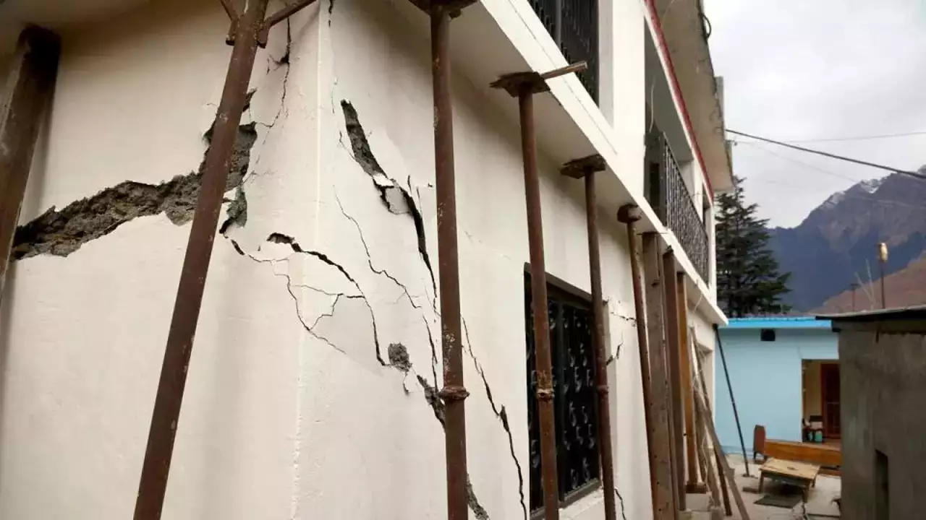
Cracks in the Paradise - Joshimath's Descent
Joshimath, once a picture of serenity, now grapples with a disturbing reality. Alarming cracks have begun to snake across buildings, a testament to the uneven land subsidence gripping the town. This geological phenomenon has forced the heartbreaking displacement of hundreds of families, leaving their homes and livelihoods behind. The once vibrant community now faces an uncertain future, highlighting the urgency of addressing the environmental consequences of unchecked development.

Slide 4
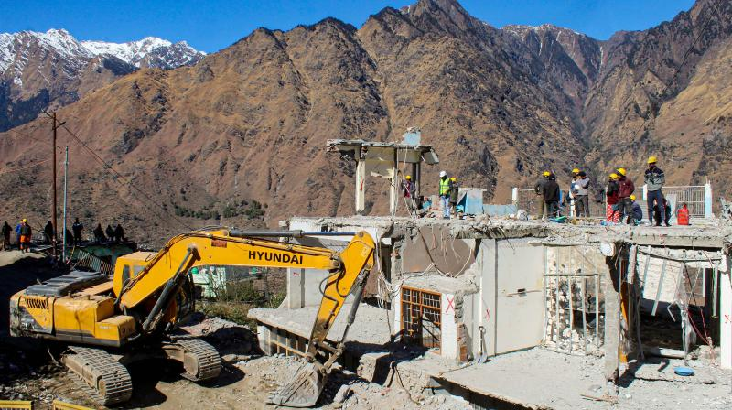
Uncontrolled Development - A Recipe for Disaster
Experts point to uncontrolled construction activities as the primary culprit behind Joshimath's woes. The town's fragile Himalayan ecosystem simply couldn't withstand the strain of extensive development projects. The construction of roads, hotels, and other infrastructure put immense pressure on the land, leading to subsidence and the devastating cracks we see today. Furthermore, a lack of proper regulations and environmental impact assessments exacerbated the situation. This incident underscores the critical need for responsible development practices that prioritize environmental sustainability alongside infrastructure growth.

Slide 5
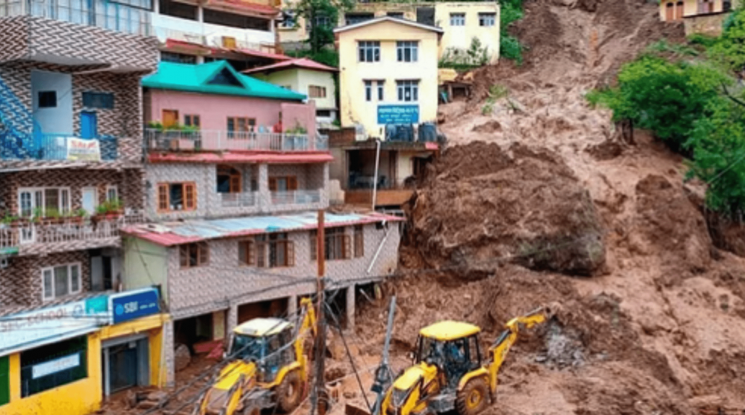
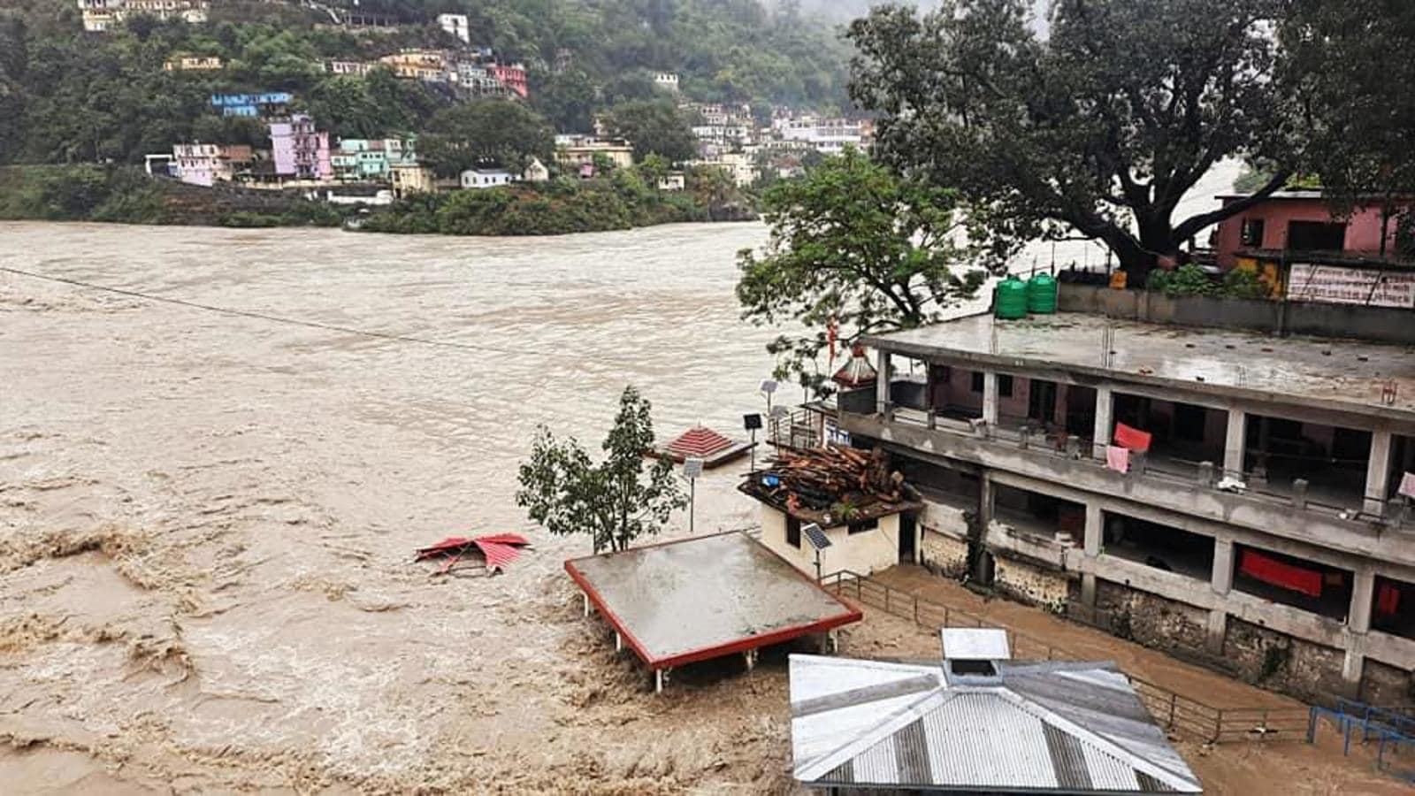
Beyond Joshimath - A Pattern of Environmental Damage
The plight of Joshimath is not an isolated incident. Uttarakhand, the state where it resides, is known for its breathtaking beauty but also for its vulnerability to natural disasters like landslides and floods. These events are often exacerbated by poor infrastructure, highlighting a concerning pattern. Joshimath serves as a stark reminder that unchecked development can push fragile ecosystems beyond their tipping point, leaving communities exposed and infrastructure vulnerable. This calls for a paradigm shift towards sustainable development practices that prioritize environmental resilience alongside progress.

Slide 6
Learning from Joshimath - A Call to Action
Joshimath's story is a wake-up call for all of us. It compels us to advocate for responsible development that considers the long-term health of our environment. The good news is that sustainable solutions exist, offering a path to build a future where progress and environmental protection coexist.
Let Joshimath be a catalyst for collective action. We can all play a role in promoting sustainable practices, holding authorities accountable, and supporting initiatives that prioritize a harmonious relationship between development and the environment. Together, we can build a more resilient future for ourselves and generations to come.

Slide 7
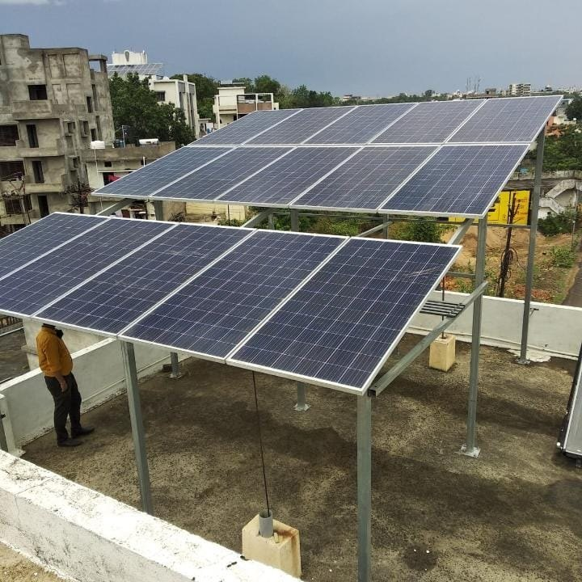
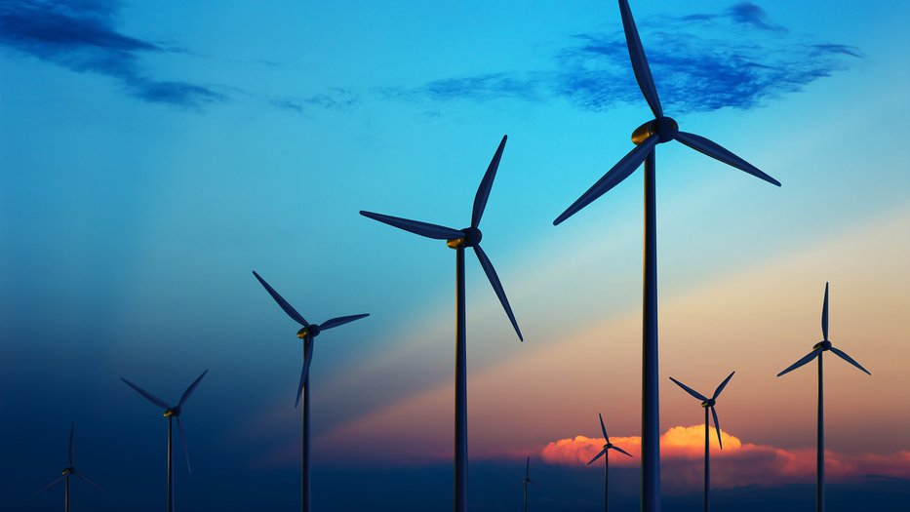
Building a Better Future - Sustainable Solutions
The story of Joshimath serves as a powerful call to action. Sustainable infrastructure development offers a path forward that ensures progress without compromising the environment.
Harnessing renewable energy sources like solar and wind power can significantly reduce our dependence on fossil fuels and their detrimental environmental impact.
Sustainable construction practices that minimize waste, utilize recycled materials, and prioritize energy efficiency are crucial for building a greener future.
Thorough environmental impact assessments before initiating any project can help identify potential risks and ensure development occurs in harmony with the surrounding ecosystem.
By embracing these sustainable solutions, we can build infrastructure that fosters economic growth while protecting our planet for generations to come.

